Slide 1

Who Shall Guard the Guardians?
Plato on
Political Office and Rule
Melissa Lane – Class of 1943 Professor of Politics
Princeton Class of ’75 Advance Reunion
January 19, 2025
melissa.lane@princeton.edu

Slide 2
The Juvenal Conundrum – and Plato
“But who shall guard the guardians themselves?”
The Roman poet Juvenal (Satire 6.347-8)
“Who of the officeholders will be sufficient to the task of being a straightener, should one of them…be crooked…in performing their office?”
Plato, Laws (12.945b5ff.)

Slide 3
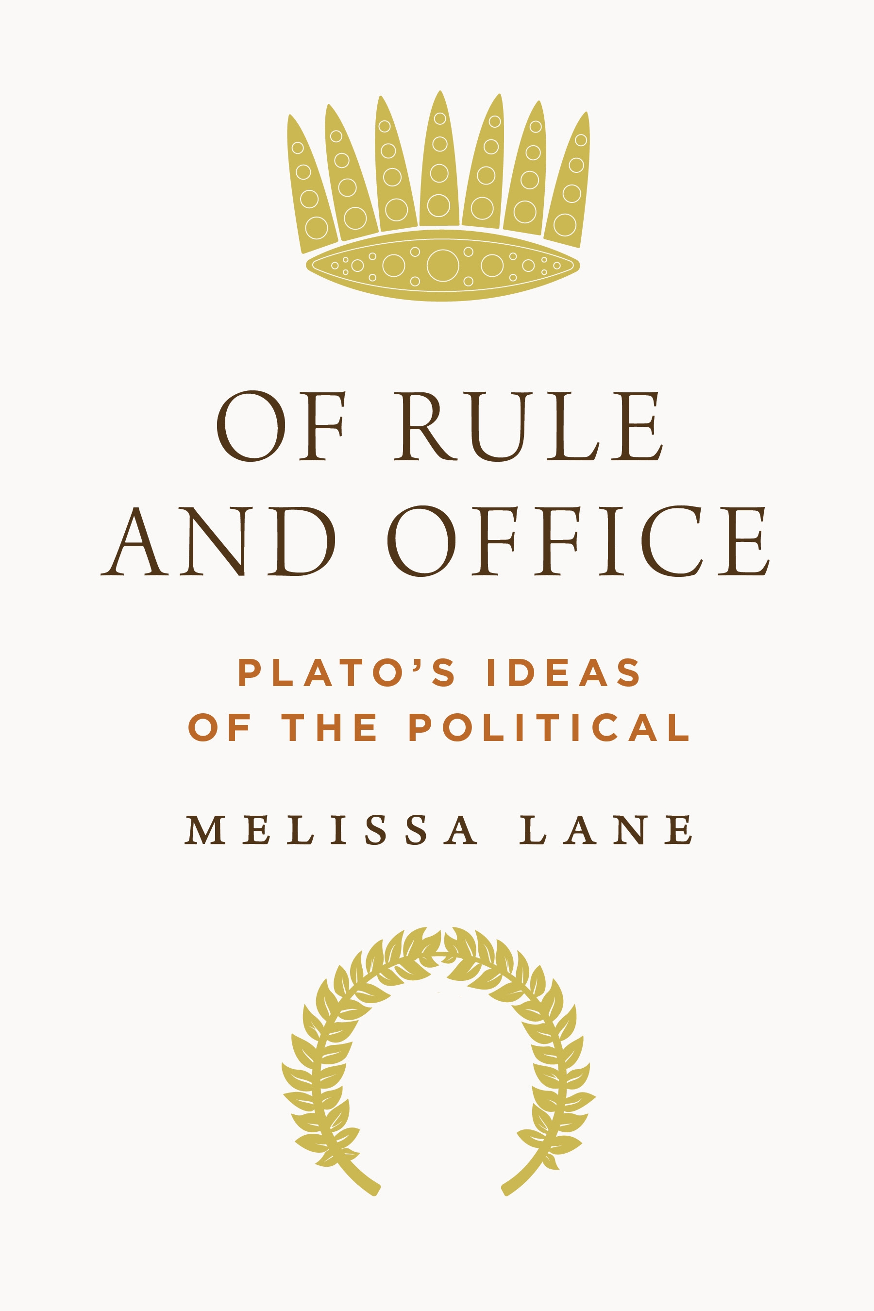

Slide 4
Plato of Athens: 424 – 347 BCE
Republic = Politeia (“Constitution”) Socrates
philosopher-rulers in ideal constitution
Statesman = Politikos (“Politician”) Eleatic Visitor
the art of statecraft is to rule, care & weave
Laws = Nomoi (“Laws”) Athenian Visitor
elected accountable officeholders in “second-best” constitution

Slide 5
Defining rule and office: same verb archein and noun archē
Rule is the genus: the power to command
Office is a constitutional species of rule: limited and controlled by law, typically through accountability
Aristotle explains that a constitution is an “order” (taxis) of “offices,” or in Greek, politeia…taxis… archōn.
(Aristotle Pol. 3.1278b8-10)
Rule and office also have telos (purpose): good of the ruled

Slide 6
Offices in ancient democratic Athens in speech by Aeschines, Against Ctesiphon 3.9-31
Limits on eligibility: e.g. age
Term limits (typically one year)
Selection mechanisms: lottery or election (latter for 1/7 exec. offices: all military, high financial)
Testing (dokimasia) before allowed to take up office
Wages (in some periods)
Audits (euthunai) in Athens to “give one’s account” (didonai ton logon)
Two stages – each a board (itself chosen by lottery)
  Financial: any citizen can accuse; officeholder answers; board can refer for trial
  General: same process

Slide 7
Offices in ancient Athens: implications of audits
“…the [Athenian] state had a lien on the property and civic freedom of all officials until their accounts were settled.”
Potential sentences: fines / exile / death.
Jennifer Tolbert Roberts
Accountability in Athenian Government (1982), 18

Slide 8
The Juvenal Conundrum – and Plato
“But who will guard the guardians themselves?”
The Roman poet Juvenal (Satire 6.347-8)
“Who of the officeholders will be sufficient to the task of being a straightener, should one of them…be crooked…in performing their office?”
Plato, Laws (12.945b5ff.)

Slide 9
Plato’s Republic: totalitarian or constitutional?
Karl Popper in The Open Society and Its Enemies (1945), vol. 1: The Spell of Plato:
Republic hinges on “the...general assumption that political power is practically unchecked, or... the demand that it ought to be so”
Plato had simply ignored the question:
“How can we so organize political institutions
that bad or incompetent rulers can be prevented
from doing too much damage?”

Slide 10
Rotation: limiting powers for highest rulers
“They must each spend most of their time with philosophy, but, when their turn (to meros) comes, they must each labor in political affairs and rule (archontas) for the city’s sake, not as if they were doing something fine, but rather something that has to be done.”
(540b1-5)

Slide 11
Accountability? No euthunai, but…
Giving an account (didonai ton logon) as political & dialectical
  Philosophers must be able to “distinguish in an account (diorisasthai tōi logōi) the form of the good from everything else…survive all refutations…striving to test (elenchein) things…and…come through all this with his account (tōi logōi) still intact” of what is good.
                (534b8-c5)
  “Then, as for those children… I don’t think that you’d allow them to be sovereign rulers in the most important offices (tōn megistōn [must supply: archōn) ) in the city while they are as irrational (alogous) as incommensurate lines. (534d3-6)

Slide 12
Testing: selection of candidate rulers
As advance from auxiliaries to officeholders to highest rulers / guardians: each age cohort tested by their elders
“must be tested (basanisteoi) to see whether they’ll remain steadfast when they’re pulled this way and that or shift their ground” (539b6-a2)
Crucial implication: no cohort is self-certifying.

Slide 13
Legal Restrictions on Rulers/Officeholders
“none of [the guardians] should acquire any private property that is not wholly necessary”
“none of them should have a house or treasury into which anyone who wishes cannot enter…”
“for them alone in the city, it is unlawful to touch or handle gold or silver”
All of this must be established “as a law”
(416d-417b)

Slide 14
Why Legal Restrictions? Constraints of Public Service
”if they acquire private land and houses and coined money…
[they will become] despots and enemies
instead of allies of the other citizens” (417b)
Rulers as “caretakers (kēdemonas) of the city” (412c)
= legal guardians

Slide 15
Wages for the guardians
“if they’re going to be guardians, they mustn’t have private houses, land, or possessions, but must receive their upkeep from the other citizens as a wage [misthos] for their guardianship and enjoy it in common”
464b8-c3

Slide 16
Rulers/ officeholders as public servants
In reply to question about how archontes are addressed by
“the people in our city”:
“they are called “preservers and auxiliaries”
In reply to questions about what archontes (rulers) “call the people”:
In other cities, archontes call them “slaves (doulous)”
In kallipolis, archontes call them “providers of wages & upkeep”
  (463a1-b8)

Slide 17
Republic on misuse of office in an oligarchy
Oligarchy: “the constitution…in which the rich hold office (archousin), while the poor have no share in office” (550c11-12)
A bankrupt oligarch will “merely seem to be one of the office holders of the city,” (552b8-11)
“Since those who are officeholders (archontes) in the city are the officeholders (archontes) because they own a lot, I suppose they’re unwilling to enact laws to prevent young people [from bankruptcy], so that by making loans to them…and then calling those loans in, they… become even richer & more honored” (555c1-5)

Slide 18
Republic on misuse of office in a democracy
The democratic city accords rich and poor alike “an equal share in the constitution and in the offices (archōn)…” (557a2-5)
“no requirement to rule even if you’re capable of it, or…to be ruled if you don’t want to be”; no preventing of anyone who wishes to “serve in public office as a juror” from doing so “even if there is a law forbidding you to do so” (557e)
“it would seem to be a pleasant constitution, one in which there is no one in office (anarchos)” (558c)
The degenerating democratic city ‘insults those who obey the rulers as willing slaves and good-for-nothings and praises and honors…rulers who behave like subjects and subjects who behave like rulers” (562d6-9)

Slide 19
Class of ’75 Question 1:
Plato & Evolving Moral Standards
“what reason had proved best
lost its absurdity to the eye”
    Republic, 452d

Slide 20
Class of ’75 Question 2:
Plato & Public Service
The paradox of democratic politics:
rulers who serve
Aristophanes, Knights: Demos’ servants/slaves
Plato’s “statesman” as both king and servant

Slide 21
Class of ’75 Question 3:
Plato & the US Supreme Court
A cabal of unelected men and women
appointed with tenure for life
making the most important decisions for a society
with no chance of appeal…

Slide 22
Further Reading
Allen, Danielle S. ’93 Why Plato Wrote (2010)
Lane, Melissa. Of Rule and Office: Plato’s Ideas of the Political (2023)
Lane, Melissa. The Birth of Politics: Eight Greek and Roman Political Ideas and Why They Matter (2015)
Lane, Melissa. “Ancient Political Philosophy.” Free: https://plato.stanford.edu/entries/ancient-political/
Waterfield, Robin. Plato of Athens: A Life in Philosophy (2023)

